Slide 1
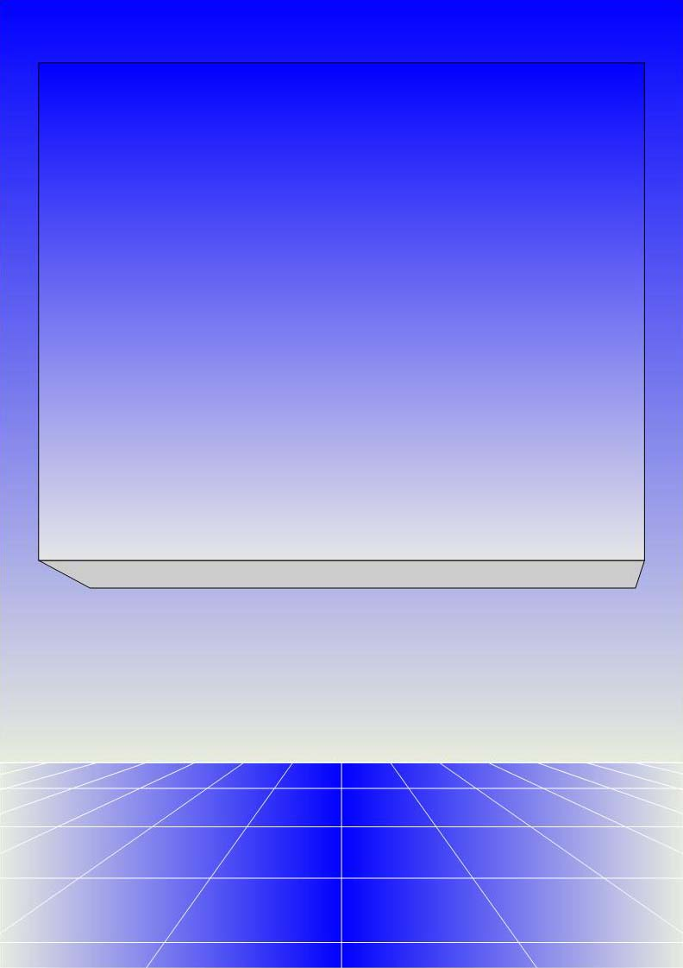
CO2402 - Advanced Programming with C++
Week 3 - Introduction to Classes
Gareth Bellaby

Slide 2

1: Introduction

Slide 3
Object Orientation
C++ is an extension of C. Created by Bjarne Stroustrup in 1979.
Stroustrup's additions allowed C to be turned into an object-oriented programming language.
Java is another example of an object-oriented language.
Object-orientation is the main contemporary programming paradigm.

Slide 4
Object Orientation
Object orientation reinforces the concept of modularisation.
However, the main argument is concerned with an understanding of the world and how we think.
It appears sensible to talk about lots of things as data types. For example, if you think about a bank account, you would think of it as a thing, an object. You would say "The balance of my account is...", "I'm adding this to my account..." or "I want to set up a direct debit on my account...". It is normal to treat complex things as objects.

Slide 5
Object Orientation
It is also normal to associate actions or operations with the object, e.g.
  withdrawing
  depositing
  checking
The data of the thing (balance, customer name) and the operations (withdrawing) are intimately connected. Indeed it feels artificial to separate one from the other.
The string class has data (the characters) and the sort of the operations we carry out with a string (calculate length, copy over).
If you are doing the games degree another example is that of a model - it has data (coordinates, orientation) but also operations (move, rotate).

Slide 6
Object-orientation
Object-oriented programs are organised around data: "data controlling access to code".
Define the data, and then the routines that are allowed to act on that data.
Object-oriented programming use a programming construct called a class.
Classes are similar to structures. They use the keyword class instead of struct.
A class is like structure but with member functions added to it.

Slide 7
Object-orientation
I want to start by showing you an example of a class. This will also introduce the word "encapsulation".
I will then briefly mention something about the use of pointers and dynamic memory.
I will finish by briefly introducing two concepts:
  inheritance
  polymorphism
Again, we'll explore all of these concepts in more detail later on in the course

Slide 8
2: Classes

Slide 9
Encapsulation
Any change to a program may have serious repercussions.
Any significant change will definitely have serious implications for the rest of the program.
For instance, the string class is very different to the ctype string.
Imagine that you've written a substantive program which uses one version and now you need to change all the text use to the other version.
This is not a matter of a simple search and replace.
Everything changes.

Slide 10
Encapsulation
Here's an example:
Your company has spent a year on developing a computer game with a budget of around half a million pounds.
The development team decided to use the string class to deal with all text.
However, you've just been told by the publisher that they are so impressed with the game that they now want to release localised versions in the Far East.

Slide 11
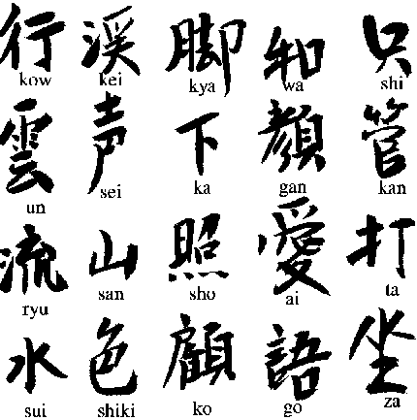
Encapsulation
Unfortunately, the string class does not support multibyte characters such as Kanji.

Slide 12
Encapsulation
You now need to change all references in the code to c-type strings.
All of the text processing will have to be changed.
You will have to test the whole of the program because this will modify the way other elements of the program.
I've used a game company as an example, but it could be any piece of software.
Every change runs the risk of undermining the software.

Slide 13
Encapsulation
If you send text off to be displayed on screen you shouldn't have to consider how the text is being displayed.
Interface and implementation should be separated.
You can change the implementation without needing to change any other code that uses the implementation.

Slide 14
Implications for C++
You write a self-enclosed mini-program called a "class".
The class has its own functions. These are called "member functions".
The class has its local data. Typically this data can only be accessed by the member functions of the class itself.
By default, we take the approach that the data used by the class cannot be accessed by any other part of the program.

Slide 15
Class definition
// Definition for a simple counter class
class Counter
{
private:
int amount; // stores the current value of amount
public:
void set( int number );
// set amount to value of number
int get( ); // get the current value of amount
void increment( );
// increment amount by 1 (trivial)
};
Note use of the keyword class.

Slide 16
private data members
You will notice two further keywords: private and public.
Encapsulation is supported by the keyword private.
private:
int amount;
A properly encapsulated class will not allow direct access to its data members. This is what private does. All code in the private section can only be accessed by the classes own member functions.
All code outside the class itself has to request access to private data. It does this by using methods provided by the class.
A class only allows indirect access via use of the classes own "getters" and "setters".

Slide 17
public member functions
The member functions of a class are typically defined as public.
public:
set( int number);
set() is a member function.
All code in the public section can be accessed outside the class.
The interface of a class is the public face it shows the rest of the world (including the rest of the program).
The only thing that the rest of the program needs to know about a class is its interface.

Slide 18
public member functions
You need to provide the code for each of the member functions.
The class definition states which functions are part of the class.
The functions themselves are defined below.
Member functions need to be defined as being part of a class. The name of the class is placed at the beginning of the function name (but after its return type). A double colon is placed after the class name
// Counter is the name of the class
void Counter::set( int number )

Slide 19
Setter
Setter: a method that sets the value of private data within a class.
Note the way that the function can access amount: a member function can access the data member as if were local to the function.
// set amount to the value of number
void Counter::set( int number )
{
amount = number;
}

Slide 20
Getter
Getter: a method that gets the value of private data from a class.
// get the current value of amount
int Counter::get()
{
return amount;
}

Slide 21
Member function
The last member function of the class increments the amount by 1.
void Counter::increment()
{
amount++;
}

Slide 22
Invoking methods
The functions (methods) of a class are invoked using the arrow operator.
// declare object of type Counter
Counter* myCount = new Counter;
myCount->set( 3 );
myCount->increment( );
int n = myCount->get( );
cout << n << endl; // output 4
delete ( myCount );

Slide 23
3: Pointers (briefly)

Slide 24
Pointers
Pointers are a special type of variable. Pointers do not store values. A pointer stores the memory location of another variable. In other words, pointers "point at" variables.
A pointer variable is declared using an asterisk (*). The asterisk is placed after the name of the data type of the pointer and before the name of the pointer itself. For example, the following code declares an Counter pointer named myCount:
Counter* myCount = new Counter;

Slide 25
Pointers
Member functions of the class are invoked using the arrow operator (hyphen followed by a right chevron).
myCount->set( 3 );

Slide 26
4: Dynamic memory (briefly)

Slide 27
Dynamic Memory Allocation
Dynamic Memory Allocation allows the program to request memory from the Operating System whilst the program is running.
Two keywords:
  new: requests memory.
  delete: releases memory.
memory leak: failing to release dynamically allocated memory. If memory is allocated but never released then the computer slowly chokes.
I will come back to the keywords new and delete and explain what is happening in more depth.

Slide 28
Memory and classes
Dynamic memory allocation is the standard way to create objects or instances of a class. Indeed, it is extremely unusual to see objects declared in any other way.
Need to use the arrow operator instead of the dot operator.
Need to free up the memory after use. This is done using the delete command.
Counter* myCount = new Counter;
myCount->set( 3 );
delete ( myCount );

Slide 29
5: Inheritance

Slide 30
Inheritance
Inheritance provides you with the ability to create new classes that are variations on an existing class.
Easy to implement.
No need to modify the existing code in any way.
For example, you could create a class with details about people - their name and address and associated functions.
We could inherit from this base class to create a student class with additional details about modules being studied.
We could also inherit from the base class to create a lecturer class with additional details about office location. The child class has all of the original data and functions but can add new data and functions.

Slide 31
Inheritance
class Lecturer :
public Person
{
private:
string room;
public:
void setRoom( string r );
// many more functions
}
class Person
{
private:
string name;
public:
void setName(string s);
// many more functions
}
class Lecturer can use setName without any additional code.

Slide 32
5: Polymorphism

Slide 33
Polymorphism
Polymorphism is a powerful extension to inheritance.
Pointers have to defined as the same type of object as which they point, e.g. a Person pointer points at a Person, a Lecturer pointer points at a Lecturer.
Polymorphism allows you to refer to a class through a pointer of the parent class.
Polymorphism allows you to forget about the type of the object being manipulated. The compiler will choose the correct function to invoke.
For example, imagine that we have a runAnimation function for an Entity in a game. A Tree and an Enemy are both entities. The Tree class and the Enemy class inherit from the Entity class. With polymorphism the compiler will invoke the correct runAnimation function for class being used.

Slide 34
class Entity
{
// many functions
}
class Tree public Entity
{
// many functions
}
class Enemy public Entity
{
// many functions
}
Entity* entities[100];
entities[0] = new Tree;
entities[1] = new Enemy;

